Slide 1

Mobile Application System Design
(Chapter 5)
Course Lecturer: Nurul Amera Muhamad Nazmi

Slide 2
CLASS ACTIVITY
(Hands-On Practice)

Slide 3
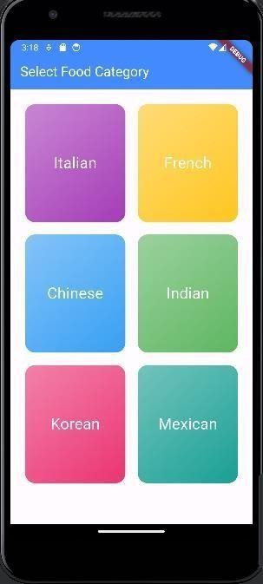
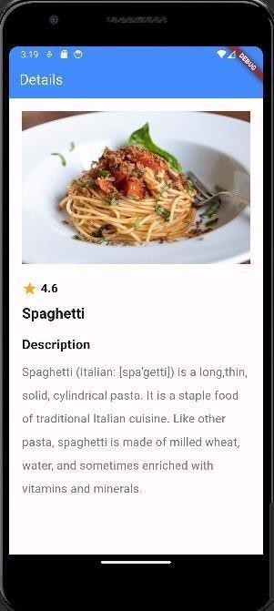
Food Category App
In this example, we will create a menu page using GridView widget.
Click

Slide 4
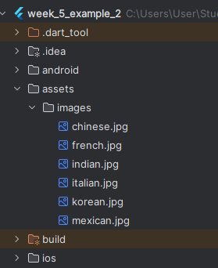
Create a new Flutter Project.
Create a folder and a sub-folder named “assets” and “images”, respectively.
Copy and paste the resources images downloaded from Moodle to the images folder.
Set the image path in pubspec.yaml.

Slide 5
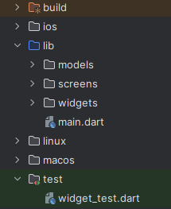
Create three subfolders named models, screens, and widgets, inside the lib folder.

Slide 6
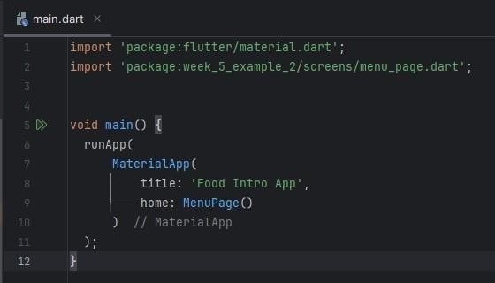
In the main.dart file, create a main
function to kictstart the app running.

Slide 7
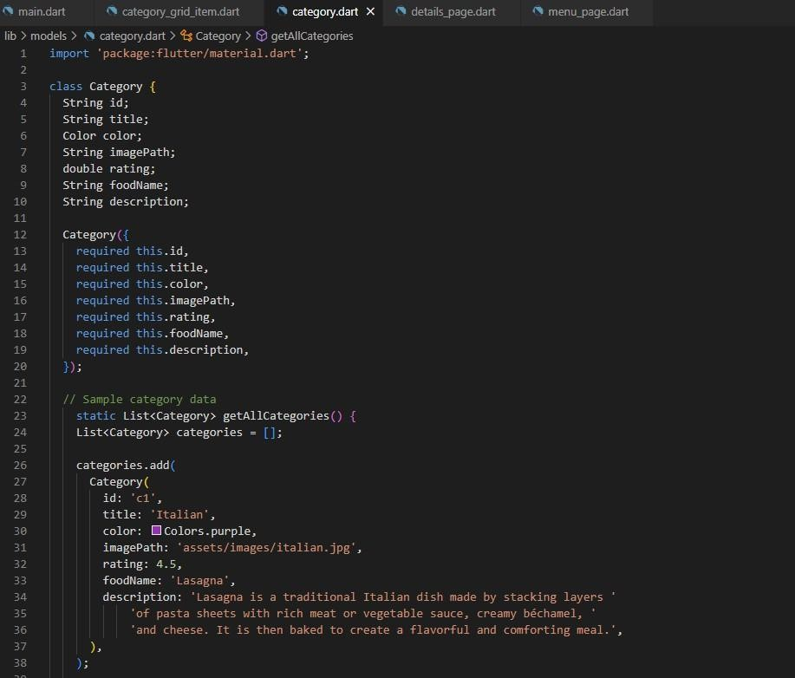
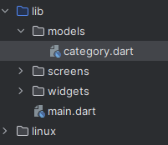
Create a new dart file named “category.dart” file in the models folder.
Copy and paste the scripts from category.txt into the category.dart file.

Slide 8
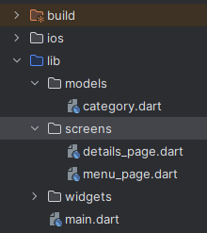
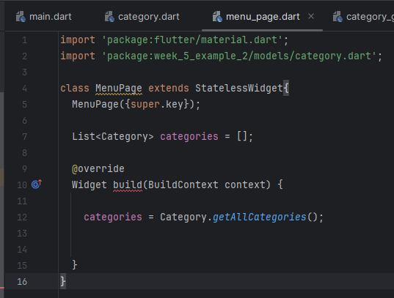
Create a new dart file named “menu_page.dart” file in the screens folder.
In menu_page.dart file, create a MenuPage class that extends the StatelessWidget.
Create a categories list and inside the build function, invokes the getAllCategories() function to extract all categories info from the data class model.

Slide 9
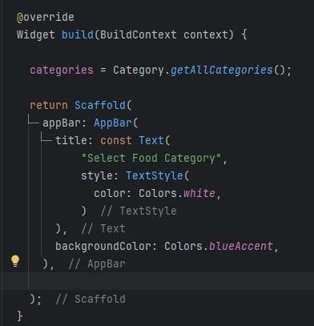
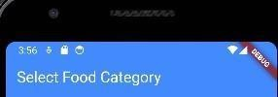
Add a Scaffold widget to the MenuPage.
Create an AppBar by setting a title.
Set the font in white color and the background as blue accent.

Slide 10
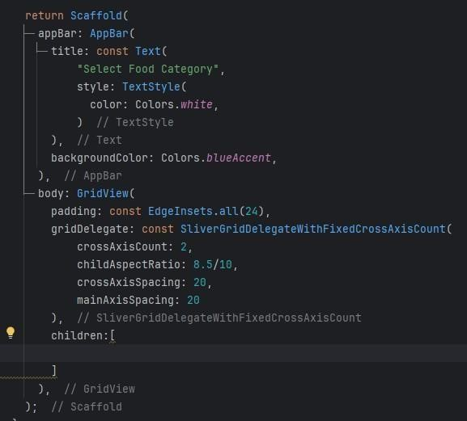
Add a Scaffold widget to
the MenuPage.
Create an AppBar by setting a title.
Set the font in white color and the background as blue accent.

Slide 11
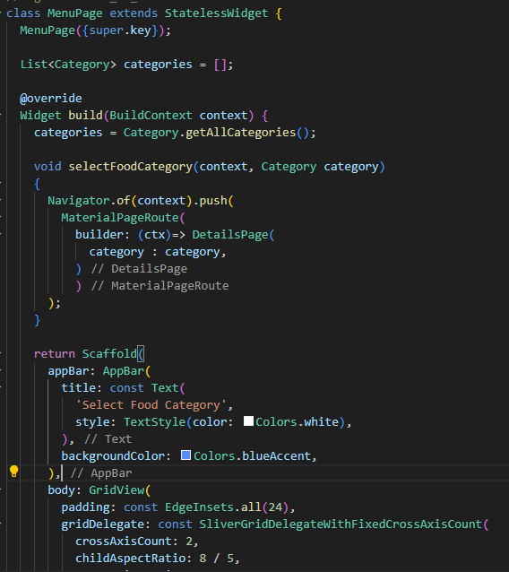

Slide 12
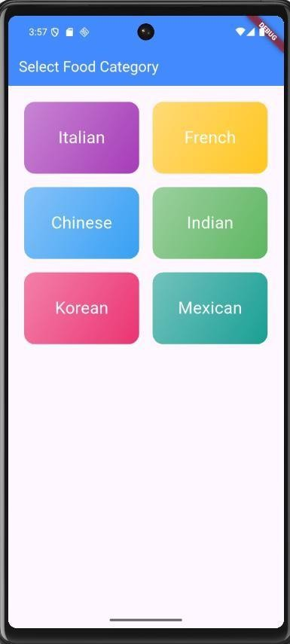

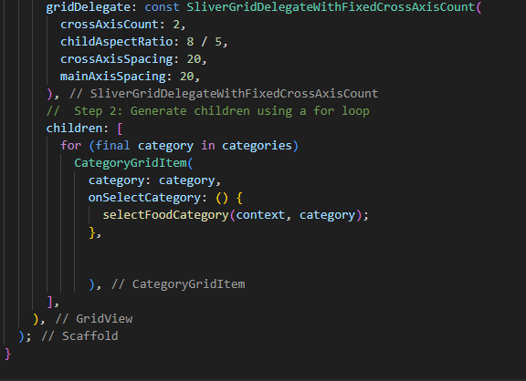
In the menu_page.dart file, add an import statement to import the category_grid_item.dart.
Create a for loop to generate the item in the GridView

Slide 13
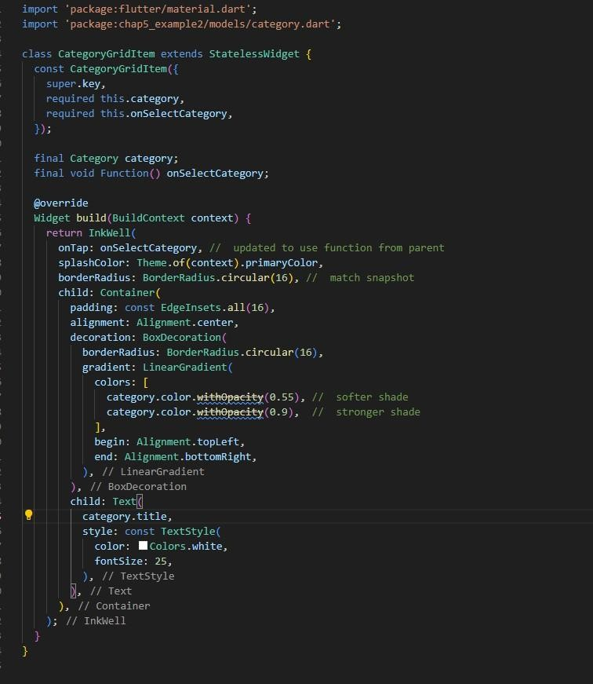
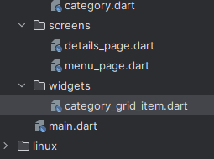
Add a new dart file named ‘category_grid_item.dart’ inside the widgets folder.
Copy and paste the scripts from ‘category_grid_item.txt’ given in the resource folder to the category_grid_item.dart.

Slide 14
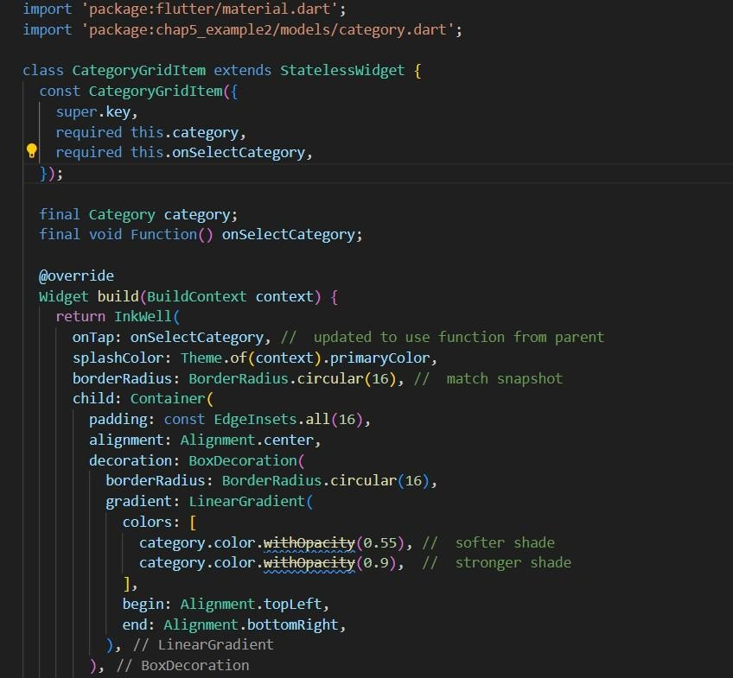
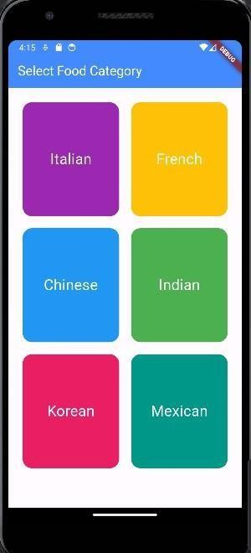
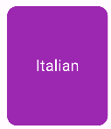
A widget that effectively simulates material design ink splash on any widget for visual interactivity

Slide 15
See you next class

